Slide 1
Using the Census Bureau's American Community Survey Data Correctly
------------------------------------------------------
Roger Magnus
Roger Magnus Research
Amherst, MA
Phone: 413-687-8466
Email: roger@rogermagnusresearch.com
Web: www.rogermagnusresearch.com

Slide 2
Who is Your Trainer?
Bachelor’s – English – Tulane University (New Orleans, LA) and Master’s - Library and Information Science – University of Texas at Austin (Austin, TX)
Business and Demographics librarian/researcher 15+ years; own research business - Roger Magnus Research
Position State Library of North Carolina in mid 2000’s - Point person for answering Census questions from all over the state
Position at UMASS Donahue Institute (2008-2010) - Surveyed Group Quarters in MA to help create annual population estimates
Articles about using ACS data –
“Delivering Data: The American Community Survey” Online Searcher Sept.- Oct. 2016
ACS Statistical Testing Tool - Online Searcher – coming out Nov. 2019

Slide 3
Major Census Population Programs
Decennial Census
Population Estimates
American Community Survey

Slide 4
Decennial Census
Decennial Census - https://www.census.gov/programs-surveys/decennial-census/data.html
Every 10 years for April 1 of year ending in 0
No Margin of Error - 100% count or approximated to it
Down to Block Level – smallest Census geography
Basic variables: Population and Housing Counts and Breakdowns by gender, age, race, Hispanic origin, native American, Two or More Races, etc.

Slide 5
Population Estimates
Population Estimates - https://www.census.gov/programs-surveys/popest.html
Every year in-between Decennial Census on July 1 including year ending in 0
Data revised retrospectively each year
No Margin of Error
Down to City/Town level for population counts
Down to County level for gender, age, gender, race, Hispanic origin

Slide 6
American Community Survey
American Community Survey (ACS) - https://www.census.gov/programs-surveys/acs.html
1-Year Average over 12 months – geographies 65,000+ population
5-Year Average over 60 months - geographies <65,000 (Exception: for Supplemental Estimates that provide 1-year average data)
Margin of Error (MOE)
Down to Block Group level – However, hard to find much data at this level due to small sample.
Many other kinds of variables including education, income, poverty, etc. – Subjects Included in the Survey - https://www.census.gov/programs-surveys/acs/guidance/subjects.html

Slide 7
Decennial Census

Slide 8
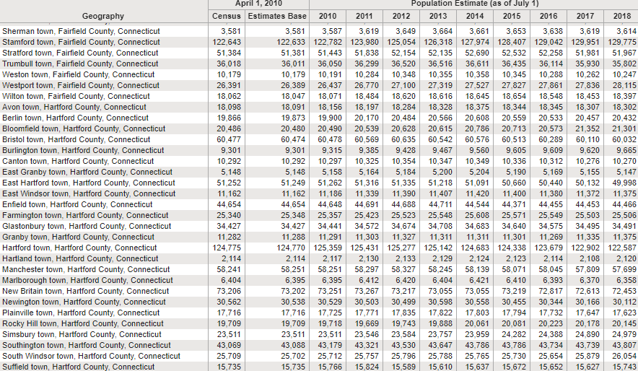
Population Estimates

Slide 9
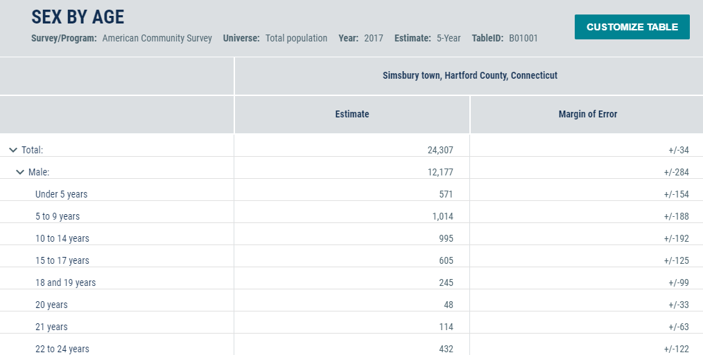
American Community Survey

Slide 10
Why Do We Care about the American Community Survey?
Data unavailable in Decennial Census or Population Estimates on education, employment, income, health, poverty, and more.
Data updated yearly (for both 1-year average and 5-year average) instead of every 10 years like the Decennial Census.
Data available down to Census Block Group (population = 600-3,000).

Slide 11
Overview of ACS
What Is the American Community Survey?
What Geographic Levels Do ACS Data Cover?
When will the 2018 ACS Data Be Released?
- How Are the Data Accessed?
- What are Margins of Error?
- How to Add or Aggregate Data
- Other Ways to Compute Data
- Comparing ACS Data
- Real Life Example #1
- Final Thoughts

Slide 12
What Is the American Community Survey?
A continuous MONTHLY survey of about 1 out of 40 households (3 million+ annually)
Estimates include MOE to 90% Confidence Level
Reason: small sample size
MOE’s MUST be included in any computations or comparisons of data
Replaced Decennial Census Summary File (SF) 3 or Long Form - 2010
Started Mid 1990s, ramped up over several years, and fully operational by 2005
Geographies go down to Census Block Group level (Decennial - Census Block level)
Contains 1-year average and 5-year average data (geographies < 65,000 population/recommended use non-overlapping years)
_______________________________________________
***Comparisons tricky
Computations or Statistical Testing Tool needed
Data tables variables definitions and scope can change from year-to-year
Income tables must account for inflation
Notes:
Visible data and that can be used to derive new data and/or comparisons.

Slide 13
What Geographic Levels Do ACS Data Cover?
Major Levels - https://www.census.gov/programs-surveys/geography/about/glossary.html
Nation
State
Congressional District
County
Place (Incorporated – New England towns)/County Subdivision)
PUMAS – 100,000 (5% sample for microdata)
ZCTA – Similar, but don’t always correspond, to 5-digit zip codes
Census Tract – 1,200-8,000 (within County) – Optimally around 4,000
Block Group – 600-3,000 (within County and Census Tract)

Slide 14
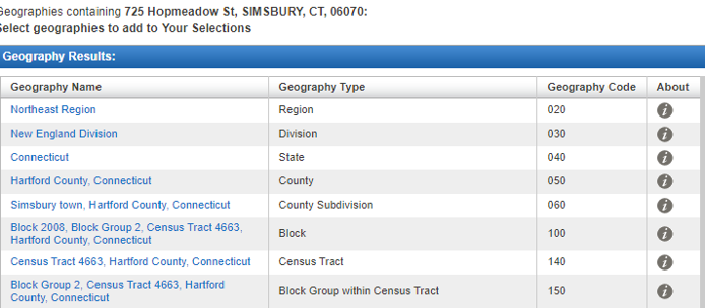
What Geographic Levels Do ACS Data Cover?
Address Search (American FactFinder – Not available in data.census.gov) https://factfinder.census.gov/faces/nav/jsf/pages/searchresults.xhtml?ref=addr&refresh=t
Notes:
AFF going away early 2020.

Slide 15
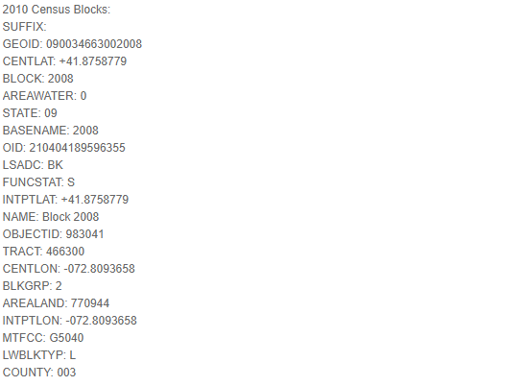
What Geographic Levels Do ACS Data Cover?
Address Search (Geocoder - can be funky/results hard to read) https://geocoding.geo.census.gov/geocoder/geographies/address?form
Notes:
Simsbury Public Library Address – 725 Hopmeadow St.

Slide 16
When Will the 2018 ACS Data Be released?
2018 ACS Data Release Dates - https://www.census.gov/programs-surveys/acs/news/data-releases/2018/release-schedule.html
1-Year – Starts Sept. 26, 2019 (Detailed Tables and Data Profiles)
5-year – Starts Dec. 19. 2019 (Detailed Tables and Data Profiles)
Notes:
Right now, only have 5-year data from 2013-2017. If we are comparing geographies with one and five year data, must use 5 year data that came out in 2018.

Slide 17
How Are the Data Accessed?
ACS Data Repositories
American FactFinder - factfinder.census.gov
Going away early 2020
Sometimes need for small geographies when data are not yet fully added to Data.census.gov or for address search
Data.census.gov
Only new data being added to
Buggy (can send comment listing problem)

Slide 18
How Are the Data Accessed?
Data Products - Tables - https://www.census.gov/acs/www/data/data-tables-and-tools/american-factfinder/
__________________________________________________
Moving to Data.census.gov:
**Detailed - Cross tabulations
Subject (topic) - https://www.census.gov/acs/www/data/data-tables-and-tools/subject-tables/ - link to AFF – S number
Supplemental – 1 year data in areas 20,000-64,999 – selected variables – State, County, Place, county subdivisions - https://www.census.gov/acs/www/data/data-tables-and-tools/supplemental-tables/ - link to AFF – K number – Moving to Data.census.gov

Slide 19
How Are the Data Accessed?
Data Products – Cont.
----------------------------------------------------------------
Moving Elsewhere:
Ranking - https://www.census.gov/acs/www/data/data-tables-and-tools/ranking-tables/ -Nation and States - 86 variables for 1-year data link to AFF – R number – Moving to FTP site.
Geographic Comparison Tables – Similar to Ranking Tables for Counties and Congressional Districts – GCT number - Moving to FTP site
Others:
Variance Replicate – 5 year data – more exact as includes co-variance - https://www.census.gov/programs-surveys/acs/data/variance-tables.html
Custom – Cost $3,000, Time: 8 weeks - https://www.census.gov/programs-surveys/acs/data/custom-tables.html

Slide 20
How Are the Data Accessed?
Data Products – Profiles (link to AFF)
_____________________________________________
Moving to Data.census.gov:
Comparison – Selected geography over several years
Data - Social, economic, housing, Demographic for selected geography (Nation? State, County, Place - https://www.census.gov/acs/www/data/data-tables-and-tools/data-profiles/2017/ - link to AFF
Selected Population – Social, economic, housing for specific race, ethnic, ancestry, country of birth groups
Others: Narrative – text and bar charts - 15 topics - Nation, State, County, Place, Census Tract, ZCTA - https://www.census.gov/acs/www/data/data-tables-and-tools/narrative-profiles/2017/

Slide 21
How Are the Data Accessed?
Data Products - Others
PUMS – Microdata (customized variables) - https://www.census.gov/programs-surveys/acs/data/pums.html
API (for programmers)- https://www.census.gov/developers/

Slide 22
How Are the Data Accessed?
Data.census.gov (Searching in flux) – Main Screen
Basic Search /I’m looking for …
Advanced Search

Slide 23
How Are the Data Accessed?
Advanced Search (Filters) (Note: Search box (top of screen) also for specific queries) - https://data.census.gov/cedsci/advanced
Find a Filter
Browse Filters (Note: Sequence on page (below) but can go in any order to conduct data search.)
Topics – Subject areas of tables (Populations and People, Housing, Education, etc.)
Geographies – Summary Levels (Nation, State, County, etc.)
Years – 2018, 2017 , … 2010
Surveys – ACS 1-year and 5-year data products
Codes – Industry codes, etc. (doesn’t apply to ACS)

Slide 24
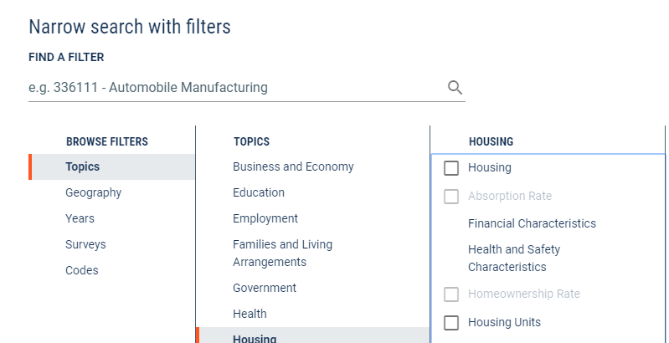
How Are the Data Accessed?
Advanced Search (Filters) - https://data.census.gov/cedsci/advanced

Slide 25
How Are the Data Accessed?
Search Strategy
Front End – Use filters to create search string.
Topics
Geography
Years
Survey
Back End – Use one filter (Topics, Geographies, etc.), Search button, and, once inside table, Customize Table button (to add other filters once data retrieved).

Slide 26
How Are the Data Accessed?
Search Strategy – Front End
Example: Commuting in Simsbury and South Windsor 2017

Slide 27
How Are the Data Accessed?
Search Strategy – Back End
Example: Commuting in Simsbury and South Windsor 2017

Slide 28
How Are the Data Accessed?
Customize Table – Other Features (Tabs along Top Screen)
Margin of Error button – Yes or No
Transpose Table – Flip
Hide/Show Columns or Rows – Customize
Download - .CSV (Excel)
More - Map

Slide 29
What Are Margins of Error?
Estimate is actually three numbers, not one.
Comes with a Lower Limit and Upper Limit due to Margin of Error (MOE) – Ex. 10,000+/- 1,500
90% Confidence Level – Census Bureau is 90% confident the real number falls within this range
* MOE MUST be reported as part of estimate (frequently is not)
Population of Simsbury: Wrong:24,307 (2017): Right: 24,307 +/-34 (2013-2017 5-year average)

Slide 30
What Are Margins of Error?

Slide 31
How to Add or Aggregate Data
Population of Simsbury and Canton: (2013-2017 5-Year Estimates) Simsbury: 24,307 +/- 34, Canton: 10,339 +/- 26)
Wrong: 24,307+ 10,339 = 34,646
Right: 34,646 +/-43 (34,403 to 34,489 90% Confident)
How to Add:
Add up the estimates: 24,307+10,339 = 34,646
Compute the Standard Error (Standard Deviation of a sample) for each town:
Simsbury: 34/1.645 (Z Score for the 90% CI) = 20.669
Canton: 26/1.645 = 15.805
Compute the Aggregate Standard Error: Sq. Root ( 20.669 Squared + 15.805 Squared) = Sq. Root (427.208 +249.813) = Sq. Root (677.021) = 26.020
Derive the Aggregate Margin of Error: 1.645* 26.020 = 42.802
FINAL ANSWER: 34,646 +/- 43
Source: https://www.census.gov/programs-surveys/acs/guidance/handbooks/general.html > Section 8

Slide 32
Other Ways to Compute Data
Calculating Proportion/Percent (Note: many tables show already with MOEs):
https://www2.census.gov/programs-surveys/acs/tech_docs/accuracy/ACS_Accuracy_of_Data_2017.pdf > Page 29 > Example 3
Ex. Proportion of Those with a Graduate or Professional Degree to Those 25+ Years Old in Simsbury:
Total Population 25+: 16,931+/-258
Graduate or Professional Degree: 5,262 +/-317

Slide 33
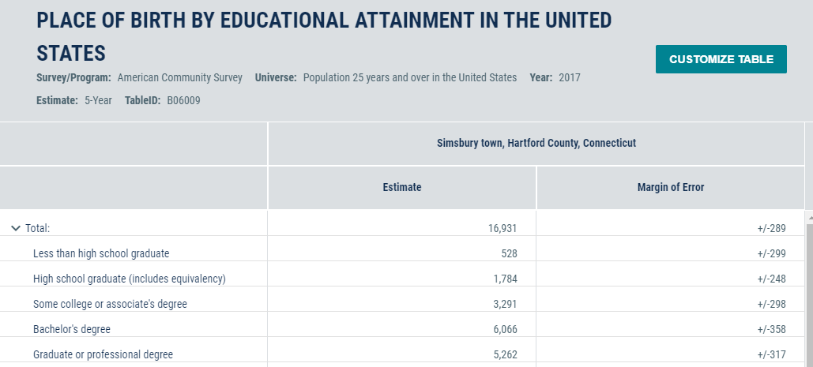
Other Ways to Compute Data

Slide 34
Other Ways to Compute Data
Calculating Proportion/Percent (Cont.):
+++++++++++++++++++++++++++++++++++++++++++
Formula: Estimate = 5,262/16,931 = 31.08%
Standard Error (Grad or Prof Degree and 25+) = 317/1.645 = 192.71
Standard Error (25+) = 258/1.645 = 156.8
Standard Error (Estimate) = 100% (1/16,931 * (Sq. Root (192.71 squared - .3108 squared * 156.84 Squared)) = 100% (.000059 * (Sq. Root (37,137.14 - .0966 * 24,598.79) = 100% (.00059*(Sq. Root (37,1314-2,376.24)) = 100% (.0059*186.44)= 100%(1.10) = .011
MOE (Estimate): .011*1.645 = .0181 or 1.81%
CI (Estimate) 31.08% +/-1.81% =29.27% to 32.89%

Slide 35
Other Ways to Compute Data
Calculating Ratio:
https://www2.census.gov/programs-surveys/acs/tech_docs/accuracy/ACS_Accuracy_of_Data_2017.pdf > Page 29 > Example 4 (Similar to Proportion calculation)
Ex. Proportion of Those 25+ with a Graduate or Professional Degree to Those with a Bachelor’s Degree:
Graduate or Professional Degree: 5,262 +/-317
Bachelor’s Degree: 6,066 +/-358

Slide 36
Other Ways to Compute Data
Adjusting for inflation with dollar-denominated variables over time - Income, Value, etc.
Uses CPI-U-RS (Consumer Price Index)
Different Formulae for comparing one and five year averages
Caveats:
National in scope and may not account for local differences
Covers all items so may not account for different prices in particular areas (housing, ie.)
Source: https://www.census.gov/programs-surveys/acs/guidance/handbooks/general.html > Section 10

Slide 37
Comparing ACS Data
Sometimes cannot compare from year-to-year
Variable definitions change.
Local Boundaries redrawn after each year.
Statistical boundaries (Census Tracts, etc.) redrawn after each Decennial Census.
Population estimate controls change with each Decennial Census,
If one geography has 5-year average data, all others being compared must also use this time frame even if 1-year average data are available (compare apples-to-apples.
**Note: For 5-year periods, recommended to compare ONLY non-overlapping years. (Ex. 2013-2017 to 2008 to 2012).

Slide 38
Comparing ACS Data
Guides:
Comparing ACS Data - https://www.census.gov/programs-surveys/acs/guidance/comparing-acs-data.html
Comparing 2017 American Community Survey Data - https://www.census.gov/programs-surveys/acs/guidance/comparing-acs-data/2017.html
Comparing 2008-2012 ACS 5-year and 2013-2017 ACS 5-year - https://www.census.gov/programs-surveys/acs/guidance/comparing-acs-data/2017/5-year-comparison.html

Slide 39
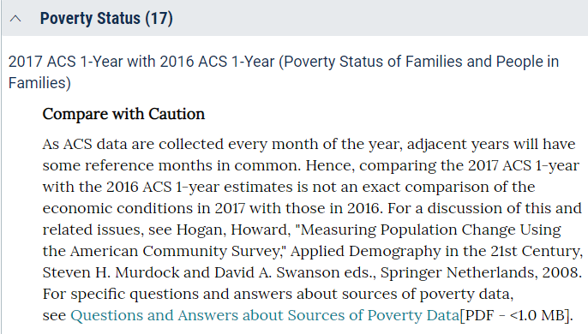
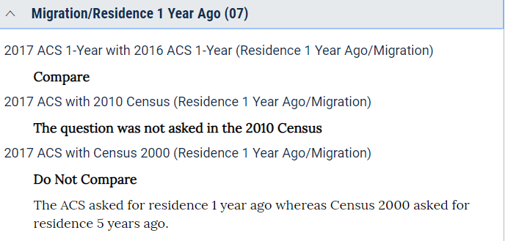
Comparing ACS Data
Stoplight Analogy for Comparing ACS Data to Previous Years:
Compare (Green)
Compare with Caution (Yellow)
Don’t Compare (Red)
EXAMPLES

Slide 40
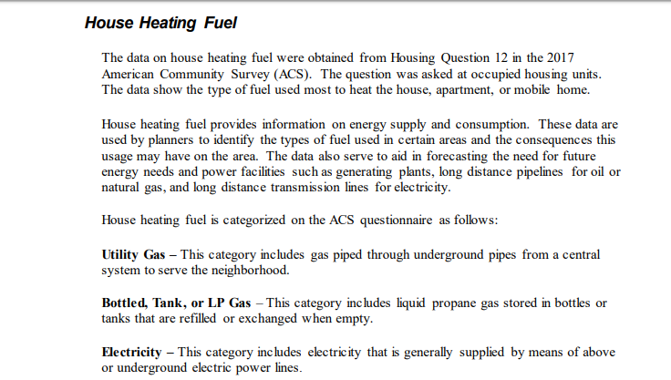
Comparing ACS Data
Subject Definitions (2017):
https://www2.census.gov/programs-surveys/acs/tech_docs/subject_definitions/2017_ACSSubjectDefinitions.pdf?
EXAMPLE:

Slide 41
Comparing ACS Data
If you are able to compare data by time frame or geography, use the Statistical Testing Tool (Excel spreadsheet) to compare 2 or multiple estimates.
https://www.census.gov/programs-surveys/acs/guidance/statistical-testing-tool.html

Slide 42
Comparing ACS Data
Statistical Testing Tool – EXAMPLE - Comparing Two Estimates

Slide 43
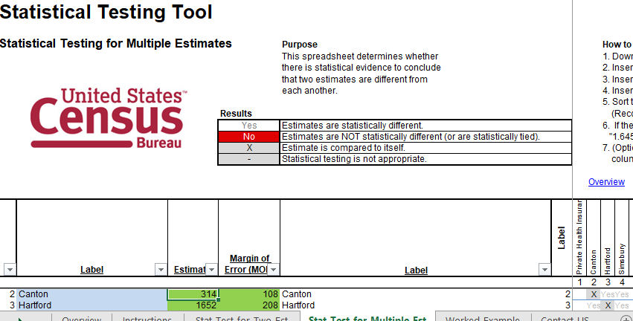
Comparing ACS Data
Statistical Testing Tool – EXAMPLE - Comparing Multiple Estimates

Slide 44
Data Quirks with ACS
Special Cases for MOE’s
***** = 0 (Often an estimate from Population Estimates Program that is controlled) – No statistical testing
0 Estimates can have MOE
- = Too few observations (Cannot do statistical testing)
N – number of cases too small and not displayed
(X) – Not applicable nor available
Others
Coefficient of Variation (CV) - SE/Estimate; Standard Error = MOE/1.645
If >61% median for all table cells, some are combined.
If still > 61%, table not published.
Optimal CV: <15% according to statistical experts

Slide 45
Real Life Example - #1
QUESTION:
Your company does home remodels and is trying to find out how many older homes (particularly before 1950) exist in three towns and if there is a significant difference in numbers between them: Avon, Simsbury, and West Hartford.

Slide 46
Real Life Example - #1
ANSWER:
Table B25034 – Year Structure Built
The three towns are all statistically significantly different from each other with 90% confidence regarding housing units before 1950.
Ranking is 1. West Hartford 2. Simsbury 3. Avon.
Bonus: What else could you compare besides raw numbers?

Slide 47
Other Useful Resources for ACS
Maps of Census Blocks (2010 Census): Useful for visualizing Block Groups and Tracts https://www.census.gov/geographies/reference-maps/2010/geo/2010-census-block-maps.html

Slide 48
Final Thoughts
ACS special and useful, but tricky and time-consuming for computations and comparisons.
Other Census population and economic programs may answer question.
Data.census.gov – work-in progress.
Data relevance not just displayed but derived.
THANK YOU!!

